Slide 1
GET TRAINED©
A program for school nurses to train school staff to administer epinephrine using an auto-injector
© 2015
Notes:
(Display slide as participants gather for presentation. Welcome all participants to this training session, introduce yourself if there is anyone who does not know you, and, depending on the size of the group being trained, ask them to introduce themselves to each other, if needed)

Slide 2
Get Trained 2016 Updates
Information in this presentation was reviewed and updated in August 2016 by:
Mary Blackborow, MSN, RN
Cathy Grano, MSN, RN,CSN

Slide 3
It’s time for all school staff to
GET TRAINED
to administer an epinephrine auto-injector
in an emergency!
This program is supported by an unrestricted grant from Mylan
Notes:
Welcome to Get Trained! In our time together, we’re going to talk about life threatening allergic reactions, and how you can give epinephrine, a lifesaving medication, in an emergency situation.

Slide 4
What Would You Do?
Bianca has a bee sting allergy
Her class is on a field trip
She tells the teacher that she was stung –
The teacher sees that she is
pale and can hear that she is
wheezing
Her tongue starts to swell,
she gasps for air
Bianca is experiencing
anaphylaxis
Bianca
Notes:
Students come to school with many different health conditions, some that require emergency care. It’s important that we know what to do – quickly and effectively – because sometimes, it can save the life of a child. Let’s consider the situation where a student – we’ll call her Bianca – is known to have a bee sting allergy. Her class is on a field trip to a local museum where the students will be eating their bag lunches outside. Bianca is stung by a bee at lunch time and tells her teacher that she was stung and that she’s having trouble breathing. The teacher looks at Bianca and sees that she is pale, her tongue appears to be swelling - she can hear her wheezing and gasping for air. Bianca needs help NOW. Do you know what to do?

Slide 5
You have moments to react
Bianca is having a life-threatening allergic reaction
Without prompt treatment with a drug called epinephrine, Bianca could die within minutes
Do you know what to do?
Do you know how to give epinephrine?
Notes:
Bianca is experiencing a life-threatening allergic reaction called anaphylaxis and the teacher in our scenario has just moments to react. Without a lifesaving medication called epinephrine given within minutes, Bianca could stop breathing. It’s important that you know what to do and how to react quickly if the school nurse is not available.
It’s important that you know how to give epinephrine.

Slide 6
BE EMPOWERED TO SAVE A LIFE -
Notes:
Today you will be empowered to save a child’s life. I’ll show you how to administer epinephrine and we’ll talk about when it’s appropriate for it to be given. I’ll answer your questions and the plan is for you to leave this training feeling confident in your ability to administer epinephrine in an emergency.

Slide 7
Objectives
Learn the signs and symptoms of anaphylaxis
Have the skills to administer an epinephrine auto-injector
Review the use of an Emergency Care Plan in responding to a student health emergency
Learn to save the life of a child like Bianca!
Notes:
Today you will be empowered to save a child’s life. I’ll show you how to administer epinephrine and we’ll talk about when it’s appropriate for it to be given. I’ll answer your questions and the plan is for you to leave this training feeling confident in your ability to administer epinephrine in an emergency.

Slide 8
Insert your state’s specific laws and regulations here
Notes:
Insert your states specific laws and regulations here

Slide 9
What is Anaphylaxis?
Notes:
The first important questions are: what happens in an allergic reaction? And what is anaphylaxis?

Slide 10
What is an allergic reaction?
An allergy occurs when the immune system sees something normal as a harmful thing
Triggers the sudden release of chemicals, including histamine, causing the reaction
The symptoms may be mild or severe – may progress over minutes or hours
FAAN, 2012
Notes:
An allergic reaction occurs when the body’s immune system mistakenly attacks a normally harmless substance (like a food protein or venom from a bee sting) that comes in contact with the body. The reaction causes the body to suddenly release a defense mechanism in the form of histamine which causes the symptoms of the allergic reaction. We’ll talk more about specific symptoms later, but the symptoms can be mild or severe. What’s interesting is that the first time the body comes in contact with the substance, there may be little or no reaction, but repeated ingestion or contact with the allergen can cause a reaction – and each reaction may produce symptoms that appear similar or different from previous episodes. It’s not always easy to describe what to expect, but when you a severe reaction happening and you wonder if it’s anaphylaxis, it probably is.

Slide 11
Allergic Reactions
Common allergens include:
Bee stings
Latex
Food - most common allergens:
Notes:
If a student has experienced an allergic reaction in the past, it’s important for them to see their healthcare provider and an allergist to be diagnosed, as there are many things that a person may be allergic to. The most common things people are allergic to, or “allergens”, are bee stings, latex and many kinds of food. Eight foods are responsible for 90% of food allergies and they are milk, egg, peanuts, tree nuts, fish, shellfish, soy and wheat. Food allergies are more common than latex allergies.

Slide 12
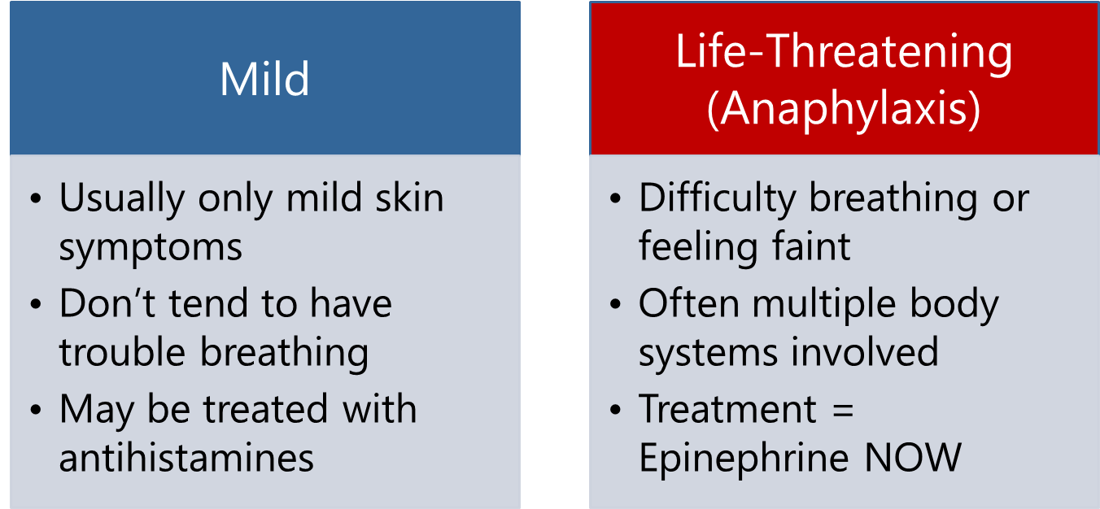
Allergic Reactions
Important to make the distinction based on the signs and symptoms seen in a student!
Fineman, 2014
Notes:
It’s important to know that some allergic reactions are mild – these usually only have signs that are related to the skin – you may see hives or discoloration, but the student would not tend to have any trouble breathing. This kind of allergic reaction can be treated with an antihistamine. There are also life-threatening reactions and students experiencing this more dramatic reaction may have difficulty breathing or feel faint. Often multiple body systems are involved – they may have trouble breathing and vomit. The treatment for this kind of allergic reaction is epinephrine – an antihistamine won’t act in time. They need epinephrine and the student will need it immediately! If a student needs epinephrine, they could die without it – and quickly. You need to know the signs and symptoms of allergic reactions so you can react right away when there is an emergency

Slide 13
Anaphylaxis (“an-a-fi-LAK-sis”)
Anaphylaxis is a severe allergic reaction that can be life-threatening in a matter of minutes
Almost always unanticipated
It must be treated immediately
The drug of choice is epinephrine
The time to learn how to give life-saving medication is NOW– it needs to be given without delay
It’s time to GET TRAINED!
Sicherer & Simons, 2007
Schoessler & White, 2013
Notes:
The severe kind of allergic reaction that can be fatal is called “anaphylaxis”. Anaphylaxis involves all major body and life organs – this isn’t seasonal allergies or rashes – this is an emergency.
As I said a moment ago, this type of reaction must be treated immediately – a person’s symptoms can progress very quickly and the reaction can become life-threatening within minutes. When a person is having an anaphylactic reaction, the FIRST thing they need is a medication called “epinephrine”. The good news is that epinephrine is made in an autoinjector, which is designed to be given by people who are not healthcare professionals – it’s made to help people feel confident giving it to another person. And that’s why we’re here today – to help you gain confidence in giving epinephrine IMMEDIATELY in an emergency situation. It’s time to “Get Trained”!

Slide 14
Allergic Management
Preventing an exposure is key
For students with a diagnosed allergy:
Know who can help!
Talk to your school nurse or healthcare coordinator
Know how to react!
Know the signs and symptoms of anaphylaxis
Learn about the student’s Action / Emergency Care Plan
Know where your student’s medication is and how to help in an emergency
IF A CHILD IS HAVING A FIRST TIME REACTION AND DOESN’T HAVE A PLAN – DON’T DELAY USING EPINEPHRINE IF NEEDED
Robinson & Ficca, 2011
Notes:
Learning to manage allergies begins with learning to prevent exposure to the allergen. We have a handout for you to take titled, “Preventing Allergic Reactions”. Once we know that a student has an allergy, it’s important to know who can help you create an “allergy aware” environment in school – and your school nurse or someone designated by the school administration can help. Our real goal is to avoid allergic reactions, but when one happens, it’s important to know how to react to the emergency situation. You need to know
▪ The signs and symptoms of anaphylaxis ▪ What’s in the student’s Emergency Care / Allergy Action Plan ▪ Where your student’s medication is and how to help in an emergency
▪ The student’s Emergency Care Plan will be helpful to you, but IF A CHILD IS HAVING A FIRST TIME REACTION AND DOESN’T HAVE A PLAN – DON’T DELAY USING EPINEPHRINE IF NEEDED

Slide 15
Allergy Management
Collaboration is vital – everyone should be aware of students with allergies
Must be willing to work as a team to keep these students safe
A Coordinated Approach / Effective Partnerships
CDC, 2013
Classroom Teachers | School Administration
Special Area Teachers | Food Service
Student Instructional Support Personnel | Facilities and Maintenance Staff
Transportation Staff | Everyone!
Notes:
It’s important for all members of the school community to work to prevent allergic reactions and respond to emergencies as needed. This includes classroom teachers, special area teachers, student instructional support personnel, paraprofessionals, food service personnel, custodial and transportation staff – everyone has a role in caring for students with allergies! When training staff members, remember to educate coaches, office staff and all of your important stakeholders. We must work together as a team to keep these students safe.

Slide 16
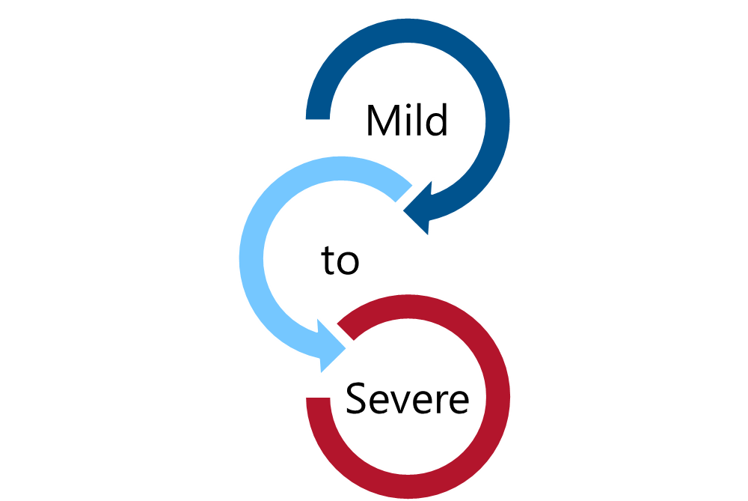
Signs and Symptoms
Notes:
Next, we’ll look at the signs and symptoms of allergic reactions.

Slide 17
What does it look like?
Mild Allergic Reaction:
MOUTH: Itchy mouth
SKIN: A few hives around mouth/face, mild itch
ABDOMINAL AREA/ STOMACH:
Mild nausea/discomfort
FARE, 2015
Notes:
The signs and symptoms of an allergic reaction can either be mild or progress to a severe reaction. A student with a mild reaction might come to you with the following concerns:
▪ An itchy mouth ▪ A few hives, or red raised bumps, around the mouth or face that may be mildly itchy ▪ A complaint of a mild upset stomach or stomach discomfort
You would want to pay attention to mild symptoms to be sure they didn’t progress to a severe reaction. When you send this child to the school nurse, never send them alone and it would be best to have an adult escort them to the school nurse’s office.

Slide 18
What does it look like?
Anaphylaxis: Any SEVERE SYMPTOMS after suspected or known ingestion or exposure:
One or more of the following:
LUNG: Short of breath, wheezing, repetitive cough
HEART: Pale, blue, faint, weak pulse, dizzy, confused
THROAT: Tight, hoarse, trouble breathing /swallowing
MOUTH: Obstructive swelling (tongue and/or lips)
SKIN: Many hives over body
FARE, 2015
Notes:
If a child with a known allergy has one or more of the following symptoms, it is indicative of a severe anaphylactic reaction:
▪ LUNG: Short of breath, wheeze, repetitive cough ▪ HEART: Pale, blue, faint, weak pulse, dizzy, confused ▪ THROAT: Tight, hoarse, trouble breathing /swallowing ▪ MOUTH: Obstructive swelling (tongue and/or lips) ▪ SKIN: Many hives over body

Slide 19
What does it look like?
Anaphylaxis: Any SEVERE SYMPTOMS after suspected or known ingestion or exposure:
Or combination of symptoms from different body areas:
SKIN: Hives, itchy rashes, swelling (e.g., eyes, lips)
ABDOMINAL AREA/ STOMACH: Vomiting, diarrhea, crampy pain
HEENT: Runny nose, sneezing, swollen eyes, phlegmy throat
OTHER: Confusion, agitation, feeling of impending doom
FARE, 2015
Notes:
Anaphylaxis is also present if you see a combination of symptoms from different body areas: Hives alone may not be a severe allergic reaction, but hives along with swelling of the eyes or lips along with nausea and vomiting would indicate an anaphylactic emergency. It’s important to realize that a student may be experiencing anaphylaxis whether you see a combination of symptoms, one symptom or before any symptoms appear.

Slide 20
How will I know what to do?
School Nurse will develop an Emergency Care Plan for students with a diagnosed allergy
Includes steps to follow
Should be reviewed regularly
Includes information from the healthcare provider/allergist
Use school protocol if available
Ask: Are signs and symptoms of possible anaphylaxis present and was there an exposure to a possible trigger?
But be ready to respond if a child doesn’t have a plan
Be prepared to act!
NASN, 2014
Notes:
So now you’ve identified that a student is experiencing the symptoms seen in a life-threatening allergic reaction – how do you know what to do? We’re going to look at that now. Students with a diagnosed allergy and an order for epinephrine should have an Emergency Care / Allergy Action Plan written by the school nurse. That plan has steps to follow – you should review the plan with the school nurse regularly so that you are able to respond in an emergency situation. It’s all part of being prepared!
Whether or not a student has a plan, you can ask yourself: Are signs and symptoms of possible anaphylaxis present and was there an exposure to a possible trigger?
Be ready to respond whether or not a child has an Emergency Care Plan

Slide 21
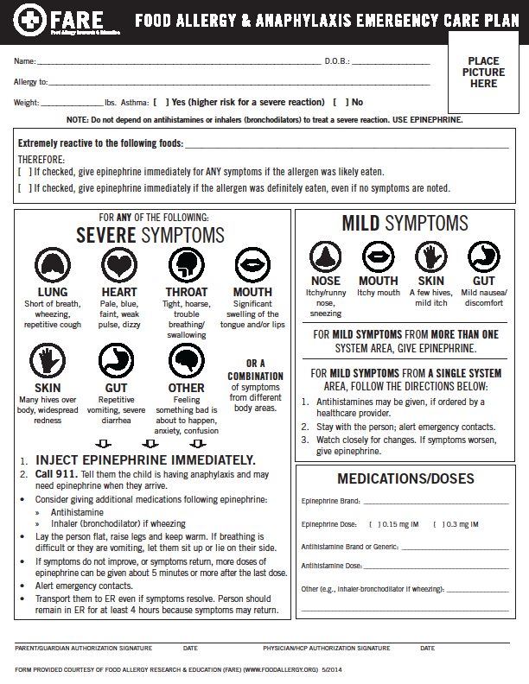
Allergy Action/Emergency Care Plan
Individual – specific to the student
Plan should be shared with school staff responsible for care
Information should be treated with care
Everyone should know where medication is and HOW TO REACT
FARE, 2014
Notes:
This is an example of an Emergency Care Plan for a food allergy. You’ll see that this is a plan that is specific to an individual student and should go to all school staff that have responsibility to care for the student. This information is confidential, as all health information is, so keep it accessible, but private.
It contains the following information:
▪ Student Name and Allergy as well as the Student’s Photo for easy identification ▪ A listing of symptoms with directions to give epinephrine ▪ A list of the brand and dose of medication (for anaphylaxis, epinephrine should be given) ▪ Information about monitoring the student – it’s important to stay with the student!
This will be your “road map” for what to do for an anaphylactic reaction!
Everyone should know where medication is and HOW TO REACT

Slide 22
Epinephrine Administration
Notes:
Let’s look at epinephrine administration so you’ll know what to do and be able to react quickly!

Slide 23
Epinephrine
Epinephrine is the drug of choice for anaphylaxis
Should be administered PROMPTLY
Some protocols call for epinephrine to be administered with or without symptoms
A delay in treatment can have devastating results
Robinson & Ficca, 2011
Sicherer & Simons, 2007
Notes:
Remember, epinephrine is the drug of choice for anaphylaxis and must be administered without delay when exposure occurs.
Research has shown that when epinephrine is delayed it leads to poor outcomes, including death. It’s important to be prepared and trained to give the epinephrine promptly when needed.
Some states have protocols that call for epinephrine to be administered after an exposure whether or not there are symptoms, but whenever epinephrine is needed, parents, teachers and school administrators should not be concerned about the health effects of epinephrine on a healthy student – it has an impressive safety profile. The worst that will happen for a healthy child will be some anxiety and palpitations. . If you say to yourself, “Gee, I wonder if I should give the ___” and epinephrine is the next word, don’t finish the sentence – just give the epinephrine and call 911 to activate Emergency Medical Services or EMS.

Slide 24
Epinephrine Auto-Injectors
Epinephrine Auto-injectors are easy to use
Come with instructions
Trainers available for practice use
Websites have video demonstrations – know how to administer your student’s auto-injector!
Epi-Pen→ video | https://www.epipen.com/en/about-epipen/how-to-use-epipen
Adrenaclick→ | http://www.adrenaclick.com/how_to_use_adrenaclick_epinephrine_injection_USP_auto_injector.php
Generic | http://www.epinephrineautoinject.com/how_to_use_epinephrine_injection_USP_auto_injector.php#
Note: All Auvi-Q epinephrine injectors with expiration dates October 2015 – December 2016 were recalled from the market.
Notes:
Epinephrine auto-injectors come with instructions and trainers are available for you to practice with. The Emergency Care / Allergy Action Plan will have the name of the brand of autoinjector that has been prescribed for your student by their healthcare provider – so that is the auto-injector that you will need to know how to use.
(At this time the trainer can show the web video for the auto-injector that the staff will need to know how to use. If more than one auto-injector has been prescribed for your students, show all video presentations. Have trainers available – demonstrate for the participants, and ideally have several on hand – or one for each participant – and after practicing with the auto-injector trainer, ask for a return demonstration from the staff member to be sure that they have learned the technique). Please see the Nurse Trainer’s Notes for additional information.

Slide 25
General Auto-injector Instructions
GET SPECIFIC DEMONSTRATION/TRAINING FROM YOUR SCHOOL NURSE
It is preferable to use training device from student’s brand of epinephrine auto-injector
Determine that the student requires epinephrine – use protocol or identify symptoms
Call 911 – have someone call EMS while you administer epinephrine
Check medication expiration date
NASN, 2014
Notes:
When learning to administer epinephrine, I can provide you with a demonstration and training.
You should always have a chance to practice with a trainer that matches the autoinjector that your student has. Be sure to know signs and symptoms – and your school may have adopted a protocol to follow – be familiar with this. (NASN has a sample protocol at http://www.nasn.org/ToolsResources/FoodAllergyandAnaphylaxis/EpinephrinePoliciesProtocols andReporting )
When you need to give epinephrine – have someone call 911 so they are on their way while you administer the life-saving medication. 911 MUST be called. Your school should keep track of the expiration dates on the autoinjectors so that they are ready for you to use

Slide 26
General Auto-injector Instructions
1
Remove safety cap from auto-injector
Place auto-injector against outer thigh
2
Push auto-injector firmly against thigh until auto-injector activates *For small children, hold thigh firmly in place before injecting
3
Hold firmly in place (check directions for the auto-injector for length of time to hold: 3 seconds or 10 seconds)
Keep device to give to EMS
Massage site for 10 seconds
Notes:
When giving an autoinjector, there are some simple steps to follow:
• Remove the safety cap from auto-injector
• Place the auto-injector against the student’s outer thigh
• Push the auto-injector firmly against the thigh until the auto-injector activates
• HOLD THE AUTOINJECTOR FIRMLY IN PLACE AGAINST THE THIGH FOR AT LEAST 10 SECONDS
• Keep the device to give to EMS

Slide 27
Steps to Follow in an Emergency
Follow the building emergency response plan/protocol and:
1. IMMEDIATELY ADMINISTER EPINEPHRINE AUTOINJECTOR PER STANDING ORDER:
0.15 mg of epinephrine for otherwise healthy young children weighing 10 to 25 kg (22 - 55 lbs.)
0.30 mg of epinephrine for those weighing 25 kg (55 lbs.) or more
Inject into middle outer side of upper leg, note time and site of injection (can be given through clothing)
Stay with student and monitor closely
2. Designate a person to call Emergency Medical System (911) and request ambulance with epinephrine
Sicherer, Scott H. and Simons, Estelle R. , 2007
Notes:
Follow the building emergency response plan/protocol and:
IMMEDIATELY ADMINISTER THE EPINEPHRINE AUTOINJECTOR PER STANDING ORDER:
▪ 0.15 mg - body weight less than 55 pounds
▪ 0.30 mg - body weight 55 pounds or more
▪ Inject into middle outer side of upper leg, note time and site of injection (can be given through clothing)
Be sure to stay with student and monitor closely until EMS (ambulance) arrives.
Designate a person to call Emergency Medical System (911) and request ambulance with epinephrine

Slide 28
Steps to Follow in an Emergency
3. Designate a person to notify, school administration, school nurse and student’s emergency contact(s)
Stay with and observe student until EMS (ambulance) arrives.
Maintain airway, monitor circulation, start CPR as necessary.
Do not have the student rise to an upright position.
Consider lying on the back with legs elevated position, but alternative positioning is needed for vomiting (side lying, head to side) or difficulty breathing (sitting).
Observe for changes until EMS arrives.
NASN, 2014
Notes:
Designate a person to notify, school administration, school nurse and student’s emergency contact(s)
Stay with and observe student until EMS (ambulance) arrives.
Maintain airway, monitor circulation, start CPR as necessary.
Do not have the student rise to an upright position.
Consider lying on the back with legs elevated position, but alternative positioning is needed for vomiting (side lying, head to side) or difficulty breathing (sitting).
Observe for changes until EMS arrives.

Slide 29
Steps to Follow in an Emergency
IF NO IMPROVEMENT OR IF SYMPTOMS WORSEN IN ABOUT 5 -15 MINUTES, (NIAID-Sponsored Expert Panel, 2010)
ADMINISTER A SECOND EPINEPHRINE DOSE according to local policy
Provide EMS with identifying information, observed signs and symptoms, time epinephrine administered, used epinephrine autoinjector to take with to the hospital
Transport to the Emergency Department via EMS even if symptoms seem to get better.
NASN, 2014
Notes:
IF NO IMPROVEMENT OR IF SYMPTOMS WORSEN IN ABOUT 5 -15 MINUTES, (NIAID-Sponsored Expert Panel, 2010)
ADMINISTER A SECOND EPINEPHRINE DOSE according to local policy
Provide EMS with identifying information, observed signs and symptoms, time epinephrine administered, used epinephrine autoinjector to take with to the hospital
Transport to the Emergency Department via EMS even if symptoms seem to get better.

Slide 30
Document and Debrief
Discuss with the school nurse how to record that you gave an epinephrine auto-injector dose and the symptoms you witnessed
Have a debriefing meeting with the nurse and school administration after giving an epinephrine auto-injector
Talk about how response went
Talk about feelings
Talk about ways to improve in the future
Robinson & Ficca, 2011
Notes:
It’s important to record what happened when a student has experienced anaphylaxis and epinephrine was given. Discuss the incident with me (the school nurse) and together we can document the symptoms you saw and the time you gave the epinephrine, as well as any other important details. It’s good to have a de-briefing meeting with the school administration and me after giving an epinephrine auto-injector to talk about how the emergency response unfolded, talk about your feelings and identify ways to improve your school’s emergency response plans

Slide 31
You Can Do It!
You know what to do when a student is having a life-threatening allergic reaction
You know how to give epinephrine
You know how to save
the lives of children
like Bianca!
Bianca
Notes:
You can do this! You now know what to do when a student is having a life-threatening allergic reaction. You know how to give epinephrine!
And know you know how to save the lives of children like Bianca

Slide 32
YOU'VE BEEN EMPOWERED TO SAVE A LIFE!
Notes:
Today you’ve been empowered to save a life.
(Pause slightly for effect!

Slide 33
Thank you for taking the time to
GET TRAINED
to administer an epinephrine auto-injector
in an emergency!
Notes:
Thank you for your time today and your commitment to the health and safety of the students in our school.
Are there any questions or concerns at this time?

Slide 34
References
Guidelines for the Diagnosis and Management of Food Allergy in the United States: Report of the NIAID-Sponsored Expert Panel (2010). Journal of Allergy and Clinical Immunology, Volume 126 , Issue 6 , S1 - S58 http://dx.doi.org/10.1016/j.jaci.2010.10.007
Centers for Disease Control and Prevention (CDC). (2013). Voluntary guidelines for managing food allergies in schools and early care and education programs. Washington DC: US Department of Health and Human Services.
Fineman, S. (2014). Optimal treatment of anaphylaxis: antihistamines versus epinephrine. Postgraduate Medicine, 126 (4), 73-81. doi: 10.3810/pgm.2014.07.2785
Food Allergy Research and Education (FARE) (2014). Retrieved from: http://www.foodallergy.org/

Slide 35
References
National Association of School Nurses (NASN). (2014) Sample protocol for treatment of anaphylaxis. Retrieved from: http://www.nasn.org/portals/0/resources/Sample_Anaphylaxis_Epinephrine_Administration_Protocol.pdf
Robinson, J. & Ficca, M. (2011). Managing the student with severe food allergies. Journal of School Nursing, 28(3), 187-194. doi: 10.1177/1059840511429686.
Schoessler, S. & White, M. (2013) Recognition and treatment of anaphylaxis in the school setting: The essential role of the school nurse. NASN School Nurse, 29: 407-415. doi: 10.1177/1059840513506014
Sicherer, S. & Simons, F.E. (2007). Self-injectable epinephrine for first aid management of anaphylaxis. Pediatrics, 119(3), 638-646. doi: 10.1542/peds.2006-3689.

